Slide 1

Fast and Secure Route to all Your Visas

Slide 2

We are…
easytovisa was founded in 2014 as a brand, with the aim of responding to the growing need for professional visa consulting on the market. In 2024 we became an independent Global mobility company.
We provide services and immigration consulting to corporate and individual clients needing to travel, work, study or live anywhere in the world.
Our expertise is based on a long-time experience in managing and supervising Visa Application Centers in various CE European countries.

Slide 3


We are able to deliver a high-quality service in the area of employment immigration in a fast, secure and reliable way.

Slide 4

Our services are provided through a network of a main hub in Belgrade and local agents/offices across multiple CEE countries.
We are so far present in: Poland, the Czech Republic, Hungary, Montenegro, Macedonia, Albania, Croatia, Bosnia and Herzegovina; whose activities are coordinated by our main office in Belgrade.
We are highly experienced travel visa experts and immigration consultants offering personalized attention and professional service.
Our experts are accustomed to meeting tight deadlines and understand the urgency of last-minute trips.
But it’s not about us…

Slide 5

It’s about You,
and Your time.

Slide 6

…and about
finding the right balance.

Slide 7




Whether you are…
Individual traveler
Business traveler
Tour operator
Government official

Slide 8

…time is the most precious resource.

Slide 9

With us, clients get a unique visa service and immigration consultancy coverage in almost every part of the world.
Our partners/clients receive special access to a global network of a leading global company in visa industry.

Slide 10

Our travel visa experts and immigration consultants will guide your employees and co-workers through complete visa application process.

Slide 11
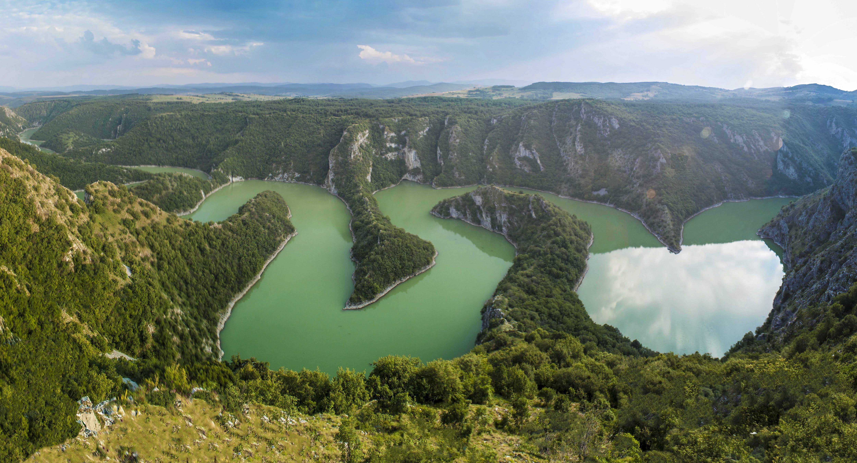



Whether our clients need to bring, post or relocate work force…
…we can provide you a full inbound immigration service package to help companies grow and their employees and their families to come, stay and work in Serbia, Macedonia, Montenegro, Croatia, Russia, Poland, Czech Republic and Hungary…

Slide 12









There is an easy way
to get your
visa
YOUR WAY
HIGHWAY
Company
Online Immigration Consulting (Skype, Viber)
On-demand mobile visa service
In person submission on applicant’s behalf
Online Visa Application Form Filling
Online Service Payment
Additional Documents Preparation
Certified Translation of Additional Documentation
Appointment Scheduling
Visa Application Tracking
Passport Collection
Passport Delivery Service
HR
Travel Agency
e-submission
Employee
Online submission
platform
Bank
Embassy/
Consular department

Slide 13


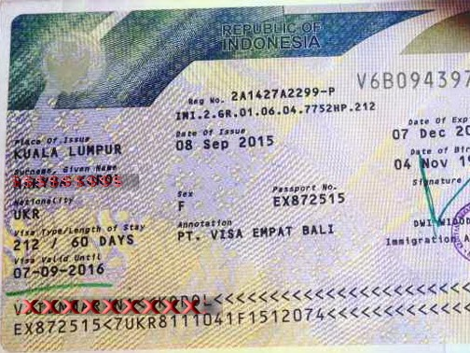

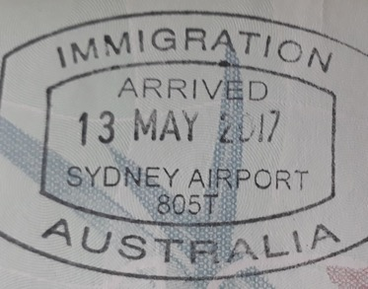
We are happy to connect with you and understand your specific needs.

Slide 14


























portfolio

Slide 15



Thank you for your attention
visas@easytovisa.com
nbekic@easytovisa.com
www.easytovisa.com

